Slide 1
The F.I.M.P. project
By: Hennok Tadesse

Slide 2
Introduction
A robotic arm that is controlled by 4 servo motors
Working with Alay Lad and Tanav Sharma
The goal is to create a robotic arm that can be controlled through a program on the raspberry pi and a mobile app.
Additional feature of the hardware project is to control the arm with a light sensor

Slide 3
Budget
Product | Price (All are final price)
MeArm kit | $61.97
Raspberry Pi 3 Starter kit | $112.99
Additional Purchases | Price
Mirco servo Motors * 2 | $5.64 * 2 = $11.28
3.3V – 5V Power Supply Module | $5.97
Total | $192.21

Slide 4
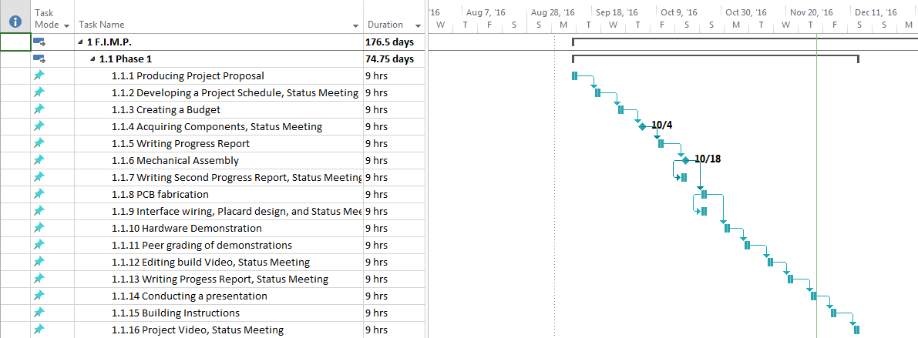
Schedule

Slide 5
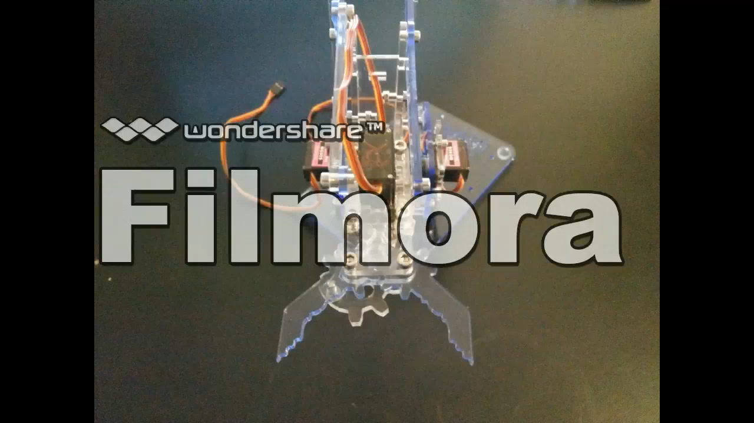
Build Video

Slide 6
Course knowledge
TECH 104 & TECH 154 – The code used to move the motors are done in C++.
CENG 252 Embedded Systems – Used embedded systems knowledge to power the motors.
CENG 200 – Used the course knowledge to navigate through the raspberry pi terminal and compile C programs.

